Slide 1
HALF CODER

Slide 2
OUR TEAM

Slide 3
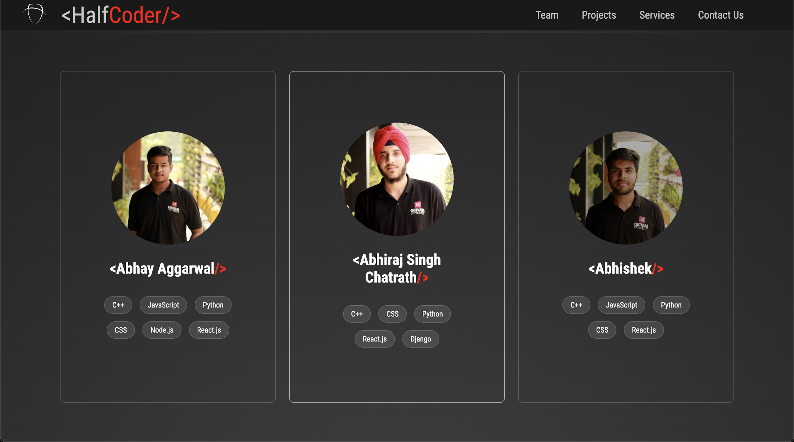

Slide 4
ABOUT OUR PROJECT
This website is created using HTML, CSS, and JavaScript. It is responsive throughout and has been deployed using github io.
This website is designed for self promotion. It can be used by companies for external team hiring.
It includes the skill levels and links of projects of all the team members individually. This include projects deployed using github and netlify.

Slide 5
ABOUT OUR PROJECT
After our platform starts gaining recognition we plan to add new features to our project.
For the time being, the developers can contact use through the numbers or email provided in the contact page.
Our future goals include adding a proper Hiring page where the developers can submit their resumes, their certifications etc. Also we plan to create a connected platform for video conferencing and giving suggestions to young developers to start thor journey in this field.

Slide 6

WEBSITE SHOWCASE

Slide 7
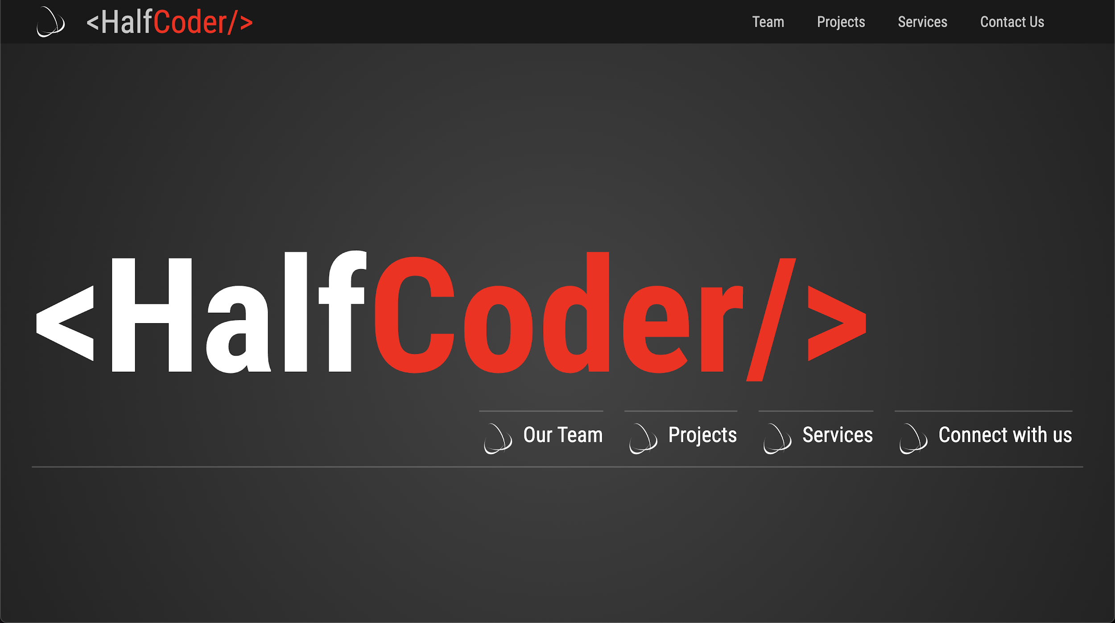
We came up with the name half coders knowing that nobody can be fully versed in coding due to its vast
scope.

Slide 8

Problem
The growing enthusiast programmers and developers face the issue of testing their skills in the current tech market due to the NOC not provided early on in colleges .
We are trying to solve this issue through our project <THE HALF CODER>

Slide 9
SOLUTION:-
WE, have started a platform which aims to hire young developers for world wide freelancing.

Slide 10
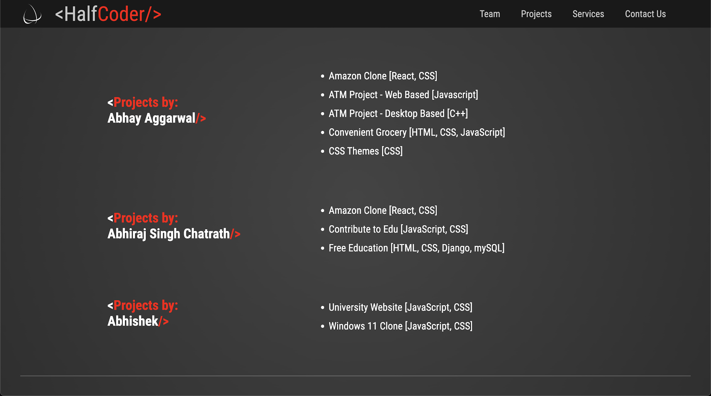

Slide 11
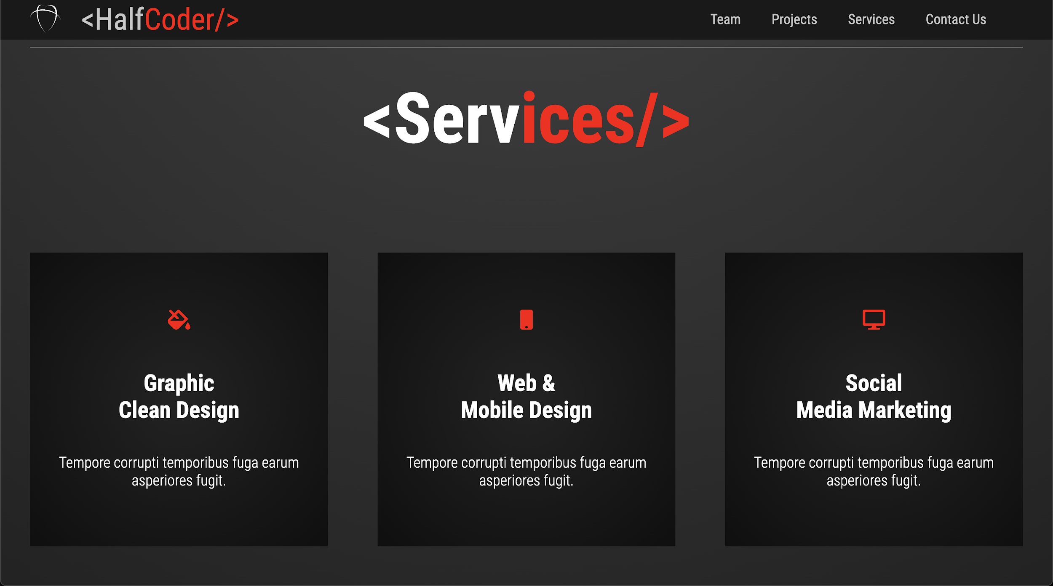

Slide 12
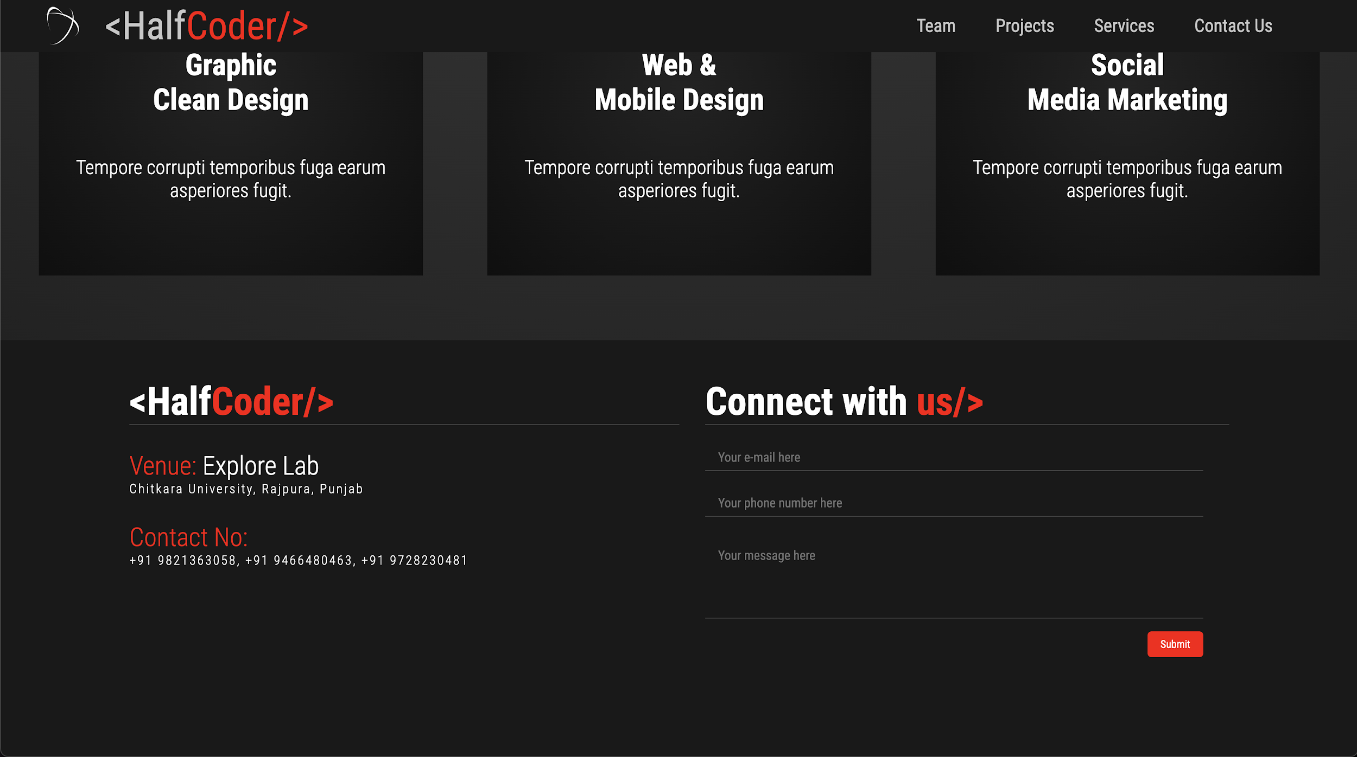

Slide 13
Thanks!

